Slide 1

Hierarchical Clustering Week 12
Machine Learning for Data Analysis MSc in Data Analytics CCT College Dublin
Lecturer: Dr. Muhammad Iqbal*
Email: miqbal@cct.ie
©CCT College Dublin 2022

Slide 2
Agenda
Unsupervised Learning: Clustering Task
Clustering Task: Similarity Measures
Hierarchical Clustering Methods
Divisive Methods
Agglomerative Methods
Single-Linkage Clustering
Complete-Linkage Clustering
Comparison of both Linkage methods
Hierarchical Clustering: Dendrogram
Single-Linkage Clustering: Example
Cluster Merging using Dendrograms: Stopping Criterion

Slide 3
Unsupervised Learning Clustering Task
Clustering refers to grouping records, observations, or tasks into classes of similar objects
Cluster is collection records similar to one another
Records in one cluster dissimilar to records in other clusters
Clustering is unsupervised data mining task
Therefore, no target variable specified
Clustering algorithms segment records and maximize homogeneity in subgroups
Similarity to records outside cluster minimized
Applying cluster analysis to enormous databases helpful
Reduces search space for downstream algorithms

Slide 4
Clustering Task Clustering Tasks in Business and Research
Target marketing for niche product, without large marketing budget
Accounting auditing: Segment behavior into benign and suspicious categories
As a dimension-reduction tool when data set has hundreds of attributes
Gene expression clustering, where genes exhibit similar characteristics
Clustering often performed as preliminary step in data mining process
Clustering results used as input to other data mining techniques
Cluster analysis addresses similar issues encountered in classification
Similarity measurement
Recoding categorical variables
Standardizing and normalizing variables
Number of clusters

Slide 5
Clustering Task Measuring Similarity
Euclidean Distance measures distance between records
where
represent the m attribute value of two records
Other distance measurements include City-Block Distance and Minkowski Distance

Slide 6
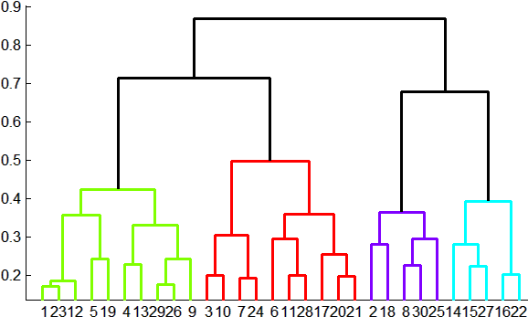
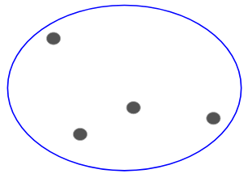
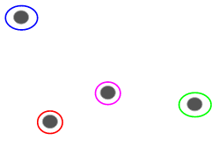
Hierarchical Clustering Methods
Clustering algorithms either Hierarchical or Non-Hierarchical
Hierarchical
Treelike cluster structure (dendogram) created through recursive partitioning (Divisive Methods) or combining (Agglomerative Methods) existing clusters
Divisive Methods
All records initialized into single cluster
At each iteration, most dissimilar record split off into separate cluster
Continues until each record represents single cluster
Divisive Clustering

Slide 7
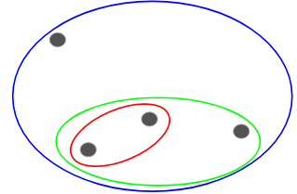
Hierarchical Clustering Methods
Agglomerative Methods
Each observation initialized to become own cluster
At each iteration two closest clusters aggregated together
Number of clusters reduced by one, each step
Eventually, all records combined into single cluster
Agglomerative more popular hierarchical method
Therefore, focus remains on this approach
Measuring distance between records straightforward once recoding and normalization applied
However, how is distance between clusters determined?
Agglomerative Clustering

Slide 8
Hierarchical Clustering Methods
Distance Between Clusters
Several criteria examined to determine distance between clusters, A and B
Single Linkage
Known as Nearest-Neighbor Approach
Minimum distance between any record in cluster A, and any record in cluster B
Cluster similarity based on most similar records from each cluster
Tends to form long, slender clusters
Sometime heterogeneous records clustered together

Slide 9
Hierarchical Clustering Methods
Measure is average distance of records in cluster A, from records in cluster B
Resulting clusters have approximately equal within-cluster variability
Next, linkage methods examined using small data set
2 5 9 15 16 18 25 33 33 45

Slide 10
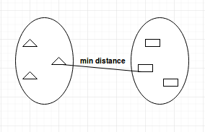
Single-Linkage Clustering
To begin, each record assigned to own cluster
Single-linkage seeks minimum distance between any two records, in separate clusters
Step 1: Minimum cluster distance is between clusters {33} and {33}. Distance = 0, clusters combined
Step 2: Clusters {15} and {16} combined, where distance = 1
Step 3: Cluster {15, 16} combined with cluster {18}
Step 4: Clusters {2} and {5} combined
2 | 5 | 9 | 15 | 16 | 18 | 25 | 33 | 33 | 45
2, 5
15, 16
33, 33
15, 16, 18

Slide 11
Single-Linkage Clustering
2 | 5 | 9 | 15 | 16 | 18 | 25 | 33 | 33 | 45
2, 5
15, 16
33, 33
2, 5, 9
15, 16, 18
2, 5, 9, 15, 16, 18
2, 5, 9, 15, 16, 18, 25
2, 5, 9, 15, 16, 18, 25, 33, 33
2, 5, 9, 15, 16, 18, 25, 33, 33, 45
Agglomeration continues similarly Steps 4 – 9
Above, last cluster {2, 5, 9, 15, 16, 18, 25, 33, 33, 45} contains all records in data set

Slide 12
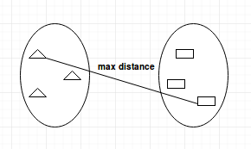
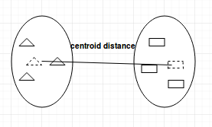
Hierarchical Clustering Methods
Complete Linkage
Known as Farthest-Neighbor Approach
Maximum distance between any record in cluster A, and any record in cluster B
Cluster similarity based on most dissimilar records from each cluster
Compact, sphere-like clusters formed
All records in cluster within given diameter of other records
Centroid-linkage
It finds centroid of cluster A and centroid of cluster B, and then calculates the distance between the two before merging.

Slide 13
Complete-Linkage Clustering
Complete-linkage explored using sample data
2 5 9 15 16 18 25 33 33 45
Distance among records in two clusters farthest from each other minimized
Step 1: Each cluster contains single record
No difference between single and Complete-linkage
Clusters {33} and {33} combined
Step 2: Clusters {15} and {16} combined
No difference between single and Complete-linkage

Slide 14
Complete-Linkage Clustering
Step 3: Complete-linkage diverges from Single-linkage
Farthest neighbors between {15, 16} and {18} are 15 and 18, distance = 3
Clusters {2} and {5} also have distance = 3
Algorithm silent regarding ties
Result, {2, 5} arbitrarily chosen
Complete-linkage procedure continues for Steps 4 – 9, until all records contained in same cluster

Slide 15
Complete and Single-Linkage Clustering Comparison
Figure illustrates Complete-linkage agglomerative clustering on sample data
Complete-linkage
Single-linkage
2 | 5 | 9 | 15 | 16 | 18 | 25 | 33 | 33 | 45
2 | 5 | 9 | 15 | 16 | 18 | 25 | 33 | 33 | 45
2, 5
15, 16
33, 33
2, 5
15, 16
33, 33
2, 5, 9
15, 16, 18
25, 33, 33
2, 5, 9
15, 16, 18
2, 5, 9, 15, 16, 18
25, 33, 33, 45
2, 5, 9, 15, 16, 18
2, 5, 9, 15, 16, 18, 25, 33, 33, 45
2, 5, 9, 15, 16, 18, 25
2, 5, 9, 15, 16, 18, 25, 33, 33
2, 5, 9, 15, 16, 18, 25, 33, 33, 45

Slide 16
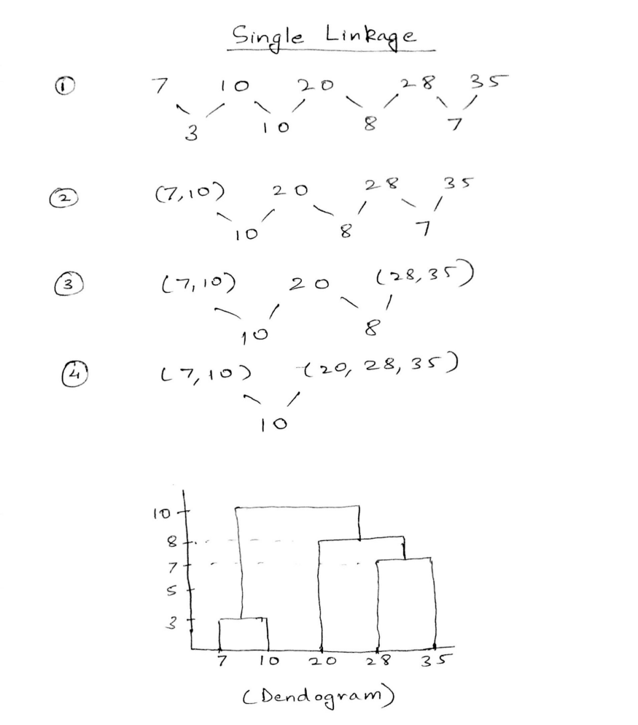
Hierarchical Clustering Dendrogram
For one dimensional data set {7, 10, 20, 28, 35}, perform hierarchical clustering and plot the dendrogram to visualize it.
We can solve this problem by hand using both the types of agglomerative hierarchical clustering (Single or Complete).
Single Linkage: In single link hierarchical clustering, we merge two clusters in each step, whose two closest members have the smallest distance.
Using single linkage, two clusters are formed
Cluster 1: (7, 10)
Cluster 2: (20, 28, 35)
20 – 10
28 – 20

Slide 17
Single Link Clustering
Problem: Assume that the database D is given by the table below. Follow single link technique to find clusters in D. Use Euclidean distance to measure.
Distance matrix
Distance matrix
 | x | y
p1 | 0.402 | 0.530
p2 | 0.220 | 0.380
p3 | 0.350 | 0.315
p4 | 0.260 | 0.189
p5 | 0.080 | 0.410
p6 | 0.450 | 0.300
p1 | 0
p2 | 0.24 | 0
p3 | 0.22 | 0.15 | 0
p4 | 0.37 | 0.20 | 0.15 | 0
p5 | 0.34 | 0.14 | 0.28 | 0.29 | 0
p6 | 0.23 | 0.24 | 0.11 | 0.22 | 0.39 | 0
 | p1 | p2 | p3 | p4 | p5 | p6
d(p₁, p₂) = 0.235 = 0.24 (rounded value)
d(i, j) = sqrt (|x_{i1} - x_{j1} |²+ | x_{i2} – x_{j2}|² + … + | x_{ip} - x_{jp}|²)
Notes:
sqrt((0.402 - 0.220)^2 + (0.530 - 0.380)^2) = 0.235
sqrt((0.402 - 0.350)^2 + (0.530 - 0.315)^2) = 0.22
sqrt((0.402 - 0.260)^2 + (0.530 - 0.189)^2) = 0.37
sqrt((0.402 - 0.080)^2 + (0.530 - 0.410)^2) = 0.34
sqrt((0.402 - 0.450)^2 + (0.530 - 0.300)^2) = 0.23
sqrt((0.22 - 0.35)^2 + (0.38 - 0.315)^2)
sqrt((0.22 - 0.26)^2 + (0.38 - 0.189)^2)
sqrt((0.22 - 0.08)^2 + (0.38 - 0.410)^2)
sqrt((0.22 - 0.45)^2 + (0.38 - 0.300)^2)
> sqrt((0.402 - 0.22)^2 + (0.53 - 0.380)^2)
[1] 0.2358474
> sqrt((0.402 - 0.35)^2 + (0.53 - 0.315)^2)
[1] 0.221199
> sqrt((0.402 - 0.26)^2 + (0.53 - 0.189)^2)
[1] 0.3693846
> sqrt((0.402 - 0.08)^2 + (0.53 - 0.410)^2)
[1] 0.3436335
> sqrt((0.402 - 0.45)^2 + (0.53 - 0.300)^2)
[1] 0.2349553
>
> sqrt((0.22 - 0.35)^2 + (0.38 - 0.315)^2)
[1] 0.1453444
> sqrt((0.22 - 0.26)^2 + (0.38 - 0.189)^2)
[1] 0.1951435
> sqrt((0.22 - 0.08)^2 + (0.38 - 0.410)^2)
[1] 0.1431782
> sqrt((0.22 - 0.45)^2 + (0.38 - 0.300)^2)
[1] 0.2435159

Slide 18
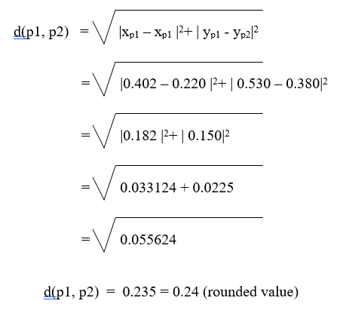
Single Link Clustering
Calculate the distance from each object (point) to all other points, using Euclidean distance measure, and place the numbers in a distance matrix.
d(i, j) = sqrt (|x_{i1} - x_{j1} |²+ | x_{i2} – x_{j2}|² + … + | x_{ip} - x_{jp}|²)
Distance matrix
p1 | 0
p2 | 0.24 | 0
p3 | 0.22 | 0.15 | 0
p4 | 0.37 | 0.20 | 0.15 | 0
p5 | 0.34 | 0.14 | 0.28 | 0.29 | 0
p6 | 0.23 | 0.24 | 0.11 | 0.22 | 0.39 | 0
 | p1 | p2 | p3 | p4 | p5 | p6
d(p₁, p₂) = 0.235 = 0.24 (rounded value)
Notes:
Lower Triangular matrix

Slide 19
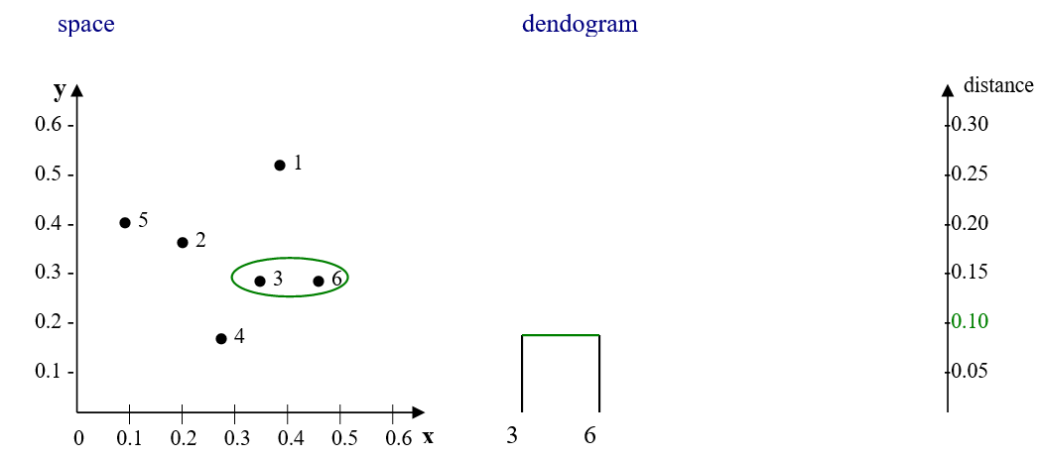
Single Link Clustering
p1 | 0
p2 | 0.24 | 0
p3 | 0.22 | 0.15 | 0
p4 | 0.37 | 0.20 | 0.15 | 0
p5 | 0.34 | 0.14 | 0.28 | 0.29 | 0
p6 | 0.23 | 0.24 | 0.11 | 0.22 | 0.39 | 0
 | p1 | p2 | p3 | p4 | p5 | p6
p1 | 0
p2 | 0.24 | 0
(p3, p6) | 0.22 | 0.15 | 0
p4 | 0.37 | 0.20 | 0.15 | 0
p5 | 0.34 | 0.14 | 0.28 | 0.29 | 0
 | p1 | p2 | (p3, p6) | p4 | p5
The minimum distance between p3 and p6 is 0.11.
First, merge these data points.

Slide 20
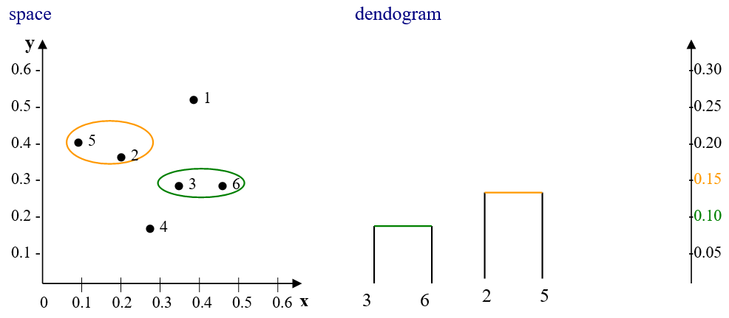
Single Link Clustering
p1 | 0
p2 | 0.24 | 0
(p3, p6) | 0.22 | 0.15 | 0
p4 | 0.37 | 0.20 | 0.15 | 0
p5 | 0.34 | 0.14 | 0.28 | 0.29 | 0
 | p1 | p2 | (p3, p6) | p4 | p5
p1 | 0
(p2, p5) | 0.24 | 0
(p3, p6) | 0.22 | 0.15 | 0
p4 | 0.37 | 0.20 | 0.15 | 0
 | p1 | (p2, p5) | (p3, p6) | p4
Next, the minimum distance between p2 and p5 is 0.14.
Second, merge these data points.

Slide 21
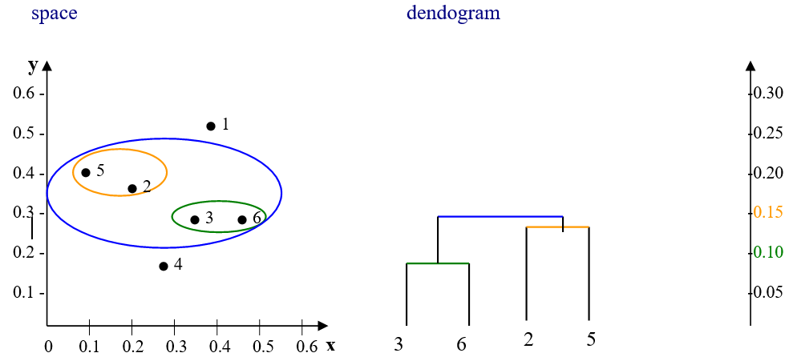
Single Link Clustering
p1 | 0
(p2, p5) | 0.24 | 0
(p3, p6) | 0.22 | 0.15 | 0
p4 | 0.37 | 0.20 | 0.15 | 0
 | p1 | (p2, p5) | (p3, p6) | p4
p1 | 0
(p2, p5, p3, p6) | 0.22 | 0
p4 | 0.37 | 0.15 | 0
 | p1 | (p2, p5, p3, p6) | p4
Next, the minimum distance between (p2, p5) and (p3, p6) is 0.15.
Third, merge these data points.

Slide 22
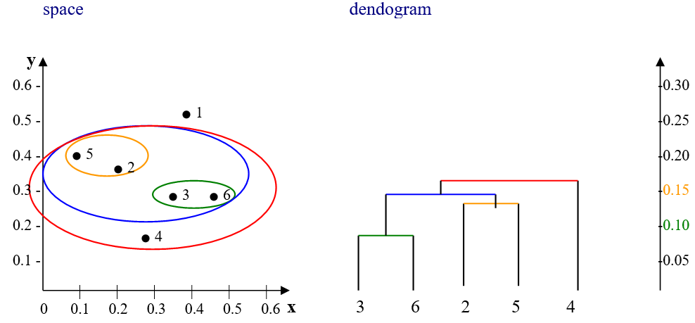
Single Link Clustering
p1 | 0
(p2, p5, p3, p6) | 0.22 | 0
p4 | 0.37 | 0.15 | 0
 | p1 | (p2, p5, p3, p6) | p4
p1 | 0
(p2, p5, p3, p6, p4) | 0.22 | 0
 | p1 | (p2, p5, p3, p6, p4)
Next, the minimum distance between (p2, p5, p3, p6) and p4 is 0.15.
Fourth, merge these data points.

Slide 23
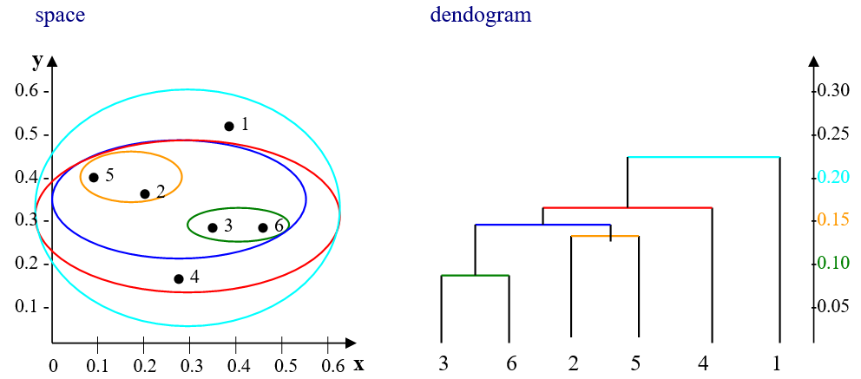
Single Link Clustering
p1 | 0
(p2, p5, p3, p6, p4) | 0.22 | 0
 | p1 | (p2, p5, p3, p6, p4)
Next, the minimum distance between (p2, p5, p3, p6, p4) and p1 is 0.22.
Last, merge these data points.

Slide 24
Hierarchical Clustering Algorithm
The key operation in hierarchical agglomerative clustering is to repeatedly combine the two nearest clusters into a larger cluster. There are three key questions that need to be answered first
How do we represent a cluster of more than one point?
How do we determine the "nearness" of clusters?
When do we stop combining clusters?
Before applying hierarchical clustering, consider the following points
It starts by calculating the distance between every pair of observation points and store it in a distance matrix.
It puts every point in its own cluster.
It starts merging the closest pairs of points based on the distances from the distance matrix and as a result, the amount of clusters goes down by 1.
It recomputes the distance between the new cluster and the old ones, and stores them in a new distance matrix.
Lastly it repeats the steps 2 and 3 until all the clusters are merged into one single cluster.

Slide 25
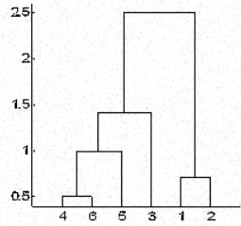
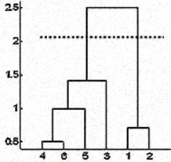
Cluster Merging using Dendrograms Stopping Criterion
How do you decide when to stop merging the clusters?
For example, if we are clustering football players on a field based on their positions on the field which will represent their coordinates for distance calculation, we already know that we should end with only 2 clusters as there can be only two teams playing a football match.
If we don't have that information too. In such cases, we can leverage the results from the dendrogram to approximate the number of clusters.
We cut the dendrogram tree with a horizontal line at a height where the line can traverse the maximum distance up and down without intersecting the merging point.
In the above case, it would be between heights 1.5 and 2.5 as shown in the figure. If we make the cut as shown, we end up with only two clusters.
The stop of merging depends on the domain knowledge about the data.

Slide 26
Linkage Methods of Clustering
There are several ways to measure the distance between clusters in order to decide the rules for clustering, and they are called Linkage Methods.
Single-linkage: calculates the minimum distance between the clusters before merging. This linkage may be used to detect high values in your dataset which may be outliers as they will be merged at the end.
Complete-linkage: calculates the maximum distance between clusters before merging.
Centroid-linkage: finds centroid of cluster 1 and centroid of cluster 2, and then calculates the distance between the two before merging.
The selection of linkage method entirely depends on the problem requirement and there is not any method that will always give us good results. Different linkage methods lead to different clusters.
Single-linkage
Complete-linkage
Centroid-linkage
Notes:
Single Linkage: In single linkage, we define the distance between two clusters as the minimum distance between any single data point in the first cluster and any single data point in the second cluster. On the basis of this definition of distance between clusters, at each stage of the process we combine the two clusters with the smallest single linkage distance.
Complete Linkage: In complete linkage, we define the distance between two clusters to be the maximum distance between any single data point in the first cluster and any single data point in the second cluster. On the basis of this definition of distance between clusters, at each stage of the process we combine the two clusters that have the smallestcomplete linkage distance.
Average Linkage: In average linkage, we define the distance between two clusters to be the average distance between data points in the first cluster and data points in the second cluster. On the basis of this definition of distance between clusters, at each stage of the process we combine the two clusters that have the smallest average linkage distance.
Centroid Method: In centroid method, the distance between two clusters is the distance between the two mean vectors of the clusters. At each stage of the process we combine the two clusters that have the smallest centroid distance.
Ward’s Method: This method does not directly define a measure of distance between two points or clusters. It is an ANOVA based approach. One-way univariate ANOVAs are done for each variable with groups defined by the clusters at that stage of the process. At each stage, two clusters merge that provide the smallest increase in the combined error sum of squares.

Slide 27
Hierarchical Clustering Animation
(5,3)
o
(1,2)
o
o (2,1) o (4,1)
o (0,0) o (5,0)
x (1.5,1.5)
x (4.7,1.3)
x (1,1)
x (4.5,0.5)
Data:
o … data point
x … centroid
Dendrogram

Slide 28
Resources/ References
Discovering Knowledge In Data: An Introduction To Data Exploration, Second Edition, By Daniel Larose And Chantal Larose, John Wiley And Sons, Inc., 2014.
Introduction to Machine Learning with Python A Guide for Data Scientists, Andreas C. Müller and Sarah Guido, Copyright © 2017, O'Reilly.
Machine Learning with Python Cookbook: Practical Solutions from Preprocessing to Deep Learning Paperback – 23 Mar. 2018. by. Chris Albon
Thoughtful Machine Learning by Matthew Kirk Published by O'Reilly Media, Inc., 2014
https://towardsdatascience.com/support-vector-machines-svm-c9ef22815589
https://github.com/ApoorvRusia/Naive-Bayes-classification-on-Iris-dataset
Some images are used from google search repository to enhance the level of learning.
Sample datasets for Regression: https://www.kaggle.com/tags/regression
Copyright Notice The following material has been communicated to you by or on behalf of CCT College Dublin in accordance with the Copyright and Related Rights Act 2000 (the Act). The material may be subject to copyright under the Act and any further reproduction, communication or distribution of this material must be in accordance with the Act. Do not remove this notice

